Slide 1
PLT: Week 9
Bottom-up, LR parsing
Notes:
<νυμβερ>

Slide 2
The core of Bottom Up parsing
Core of Top-Down:
  Moving from LHS to (correct) RHS of production rules
Core of Bottom Up;
  Moving from RHS to LHS of production rules
        T-> g r
        T-> g r w
  Achieved by:
    Knowing when to shift another symbol from input on to the stack;
    Knowing when to reduce from the RHS to the LHS of production rule;
    Knowing what contextual state we are in;
    Knowing what contextual state we need to go to when new terminals/non-terminals are considered.
Notes:
<νυμβερ>
Core of bottom up: Deciding when what-looks-like a RHS of a production rule can be transformed into a LHS
tratrr

Slide 3
Making it Work
You need:
  An action Table:
    Do we Shift or Reduce
  A Go-to table;
    What contextual state’ do we move to/push on stack
  The constituent states;
  A driver algorithm:
    Coordinates the parsing
  Best illustrated by examples!

Slide 4
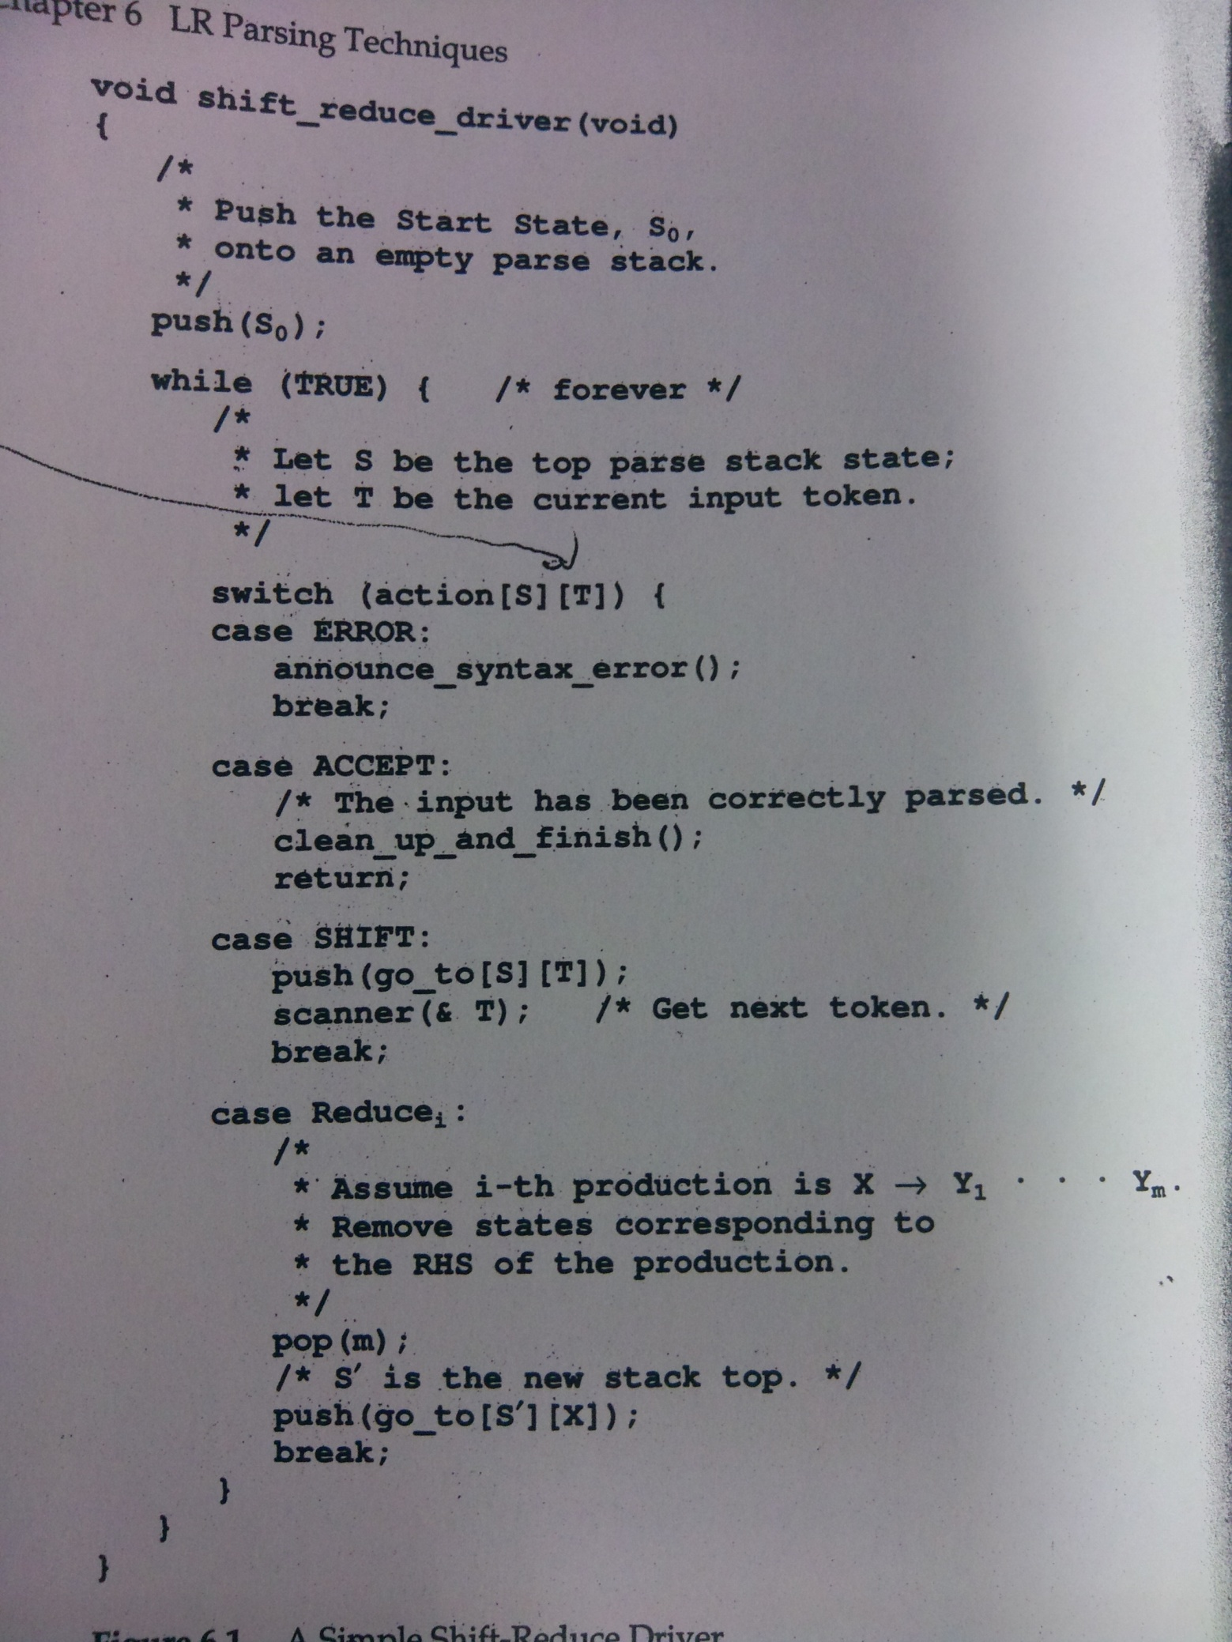
Notes:
Driver code
<νυμβερ>

Slide 5
Examples from the tutorials
First trial:
  S -> JK$
  J -> m
  J -> n
  K -> d
  K -> r //mr$
Second trial:
  S -> E$
  E -> p E E
  E -> n //pnn$

Slide 6
Bottom Up parsing
The Shift-Reduce Problem
  When to move from the RHS to LHS of production rules:
    R-> T r s
    R -> T r s g
    P -> T r s
    P -> λ
  To achieve this we
    dont just push V_{N}, V_{T} on the stack
    Push states on the stack which provide richer context:
      (All) The productions still in the hunt to be matched
      The degree to which they are matched
      The context – where we have been to get to that state;
  Modelled by an FSM that allows us create a grammar specific:
    An Action Table
    A Goto Table
  These tables can be used in conjunction with generic, driver code to LR() parse
Notes:
<νυμβερ>
Core of bottom up: Deciding when what-looks-like a RHS of a production rule can be transformed into a LHS
tratrr

Slide 7
Grammar: Your Turn
Grammar:
  S -> E$
  E -> E + T
  E -> T
  T -> d
  T -> ( E )
From this generate:
  Finite State Diagram;
  Generate the Goto table;
  Generate the Action Table (1st Cut)
  Generate the Action Table (2nd Cut)
  Parse the language Instance:
    d + ( d ) $
Notes:
<νυμβερ>

Slide 8
Optional
Show C code that:
  Generates the FSA or more correctly the CFSM;
    Based on closure function
    Based on go-to function
Show C code that:
  Generates a go-to table from the CFSM
Notes:
<νυμβερ>

Slide 9
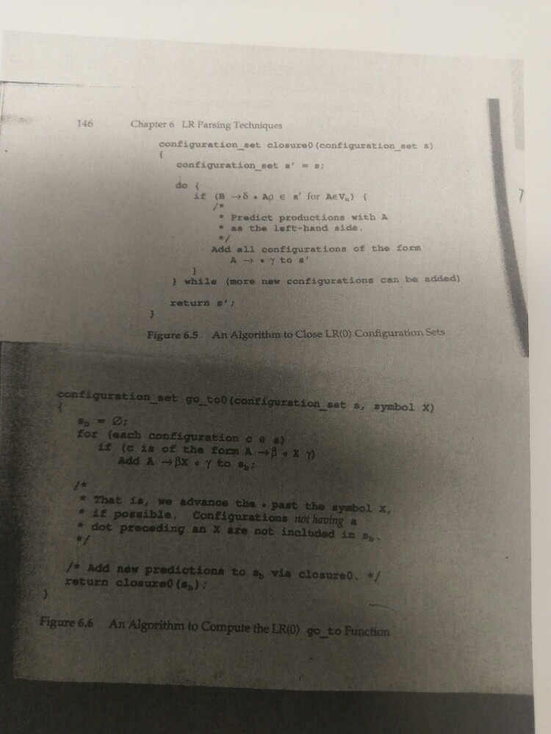
Add configs for when dot is before V_{N}
Add initial configs to state based on FSM edges
Are more configs needed based on dot being to LHS of V_{N}

Slide 10
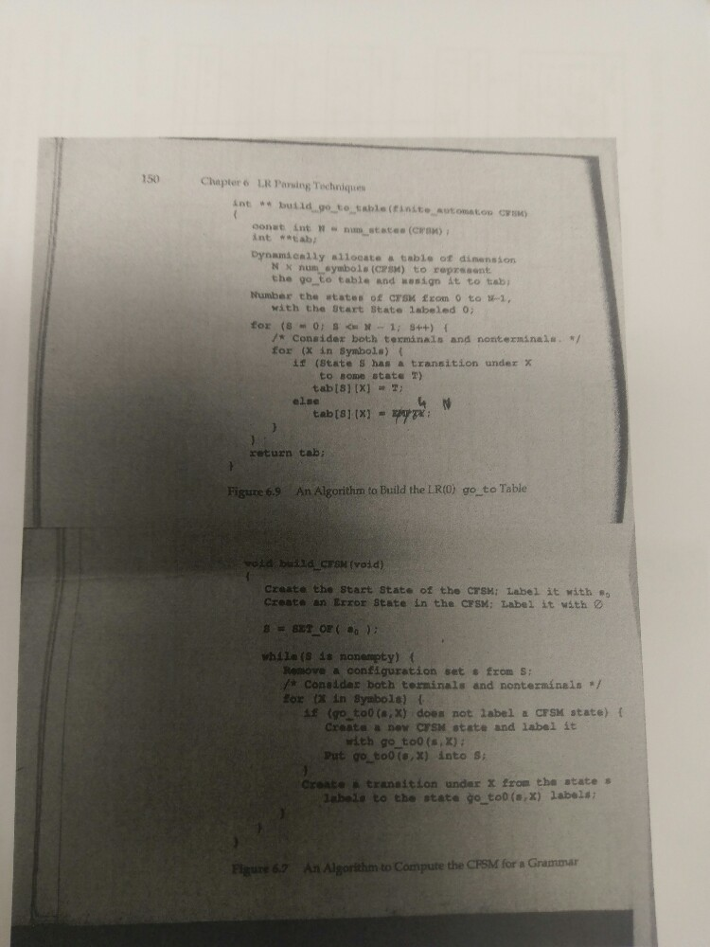
Empty state
an existing

Slide 11
LR(1)
S->E$
E->E+T
E->T
T->T*P
T->P
P->id //here id reps 1 terminal
P->(E)
What happens if we get a T transition in state S₀?

Slide 12
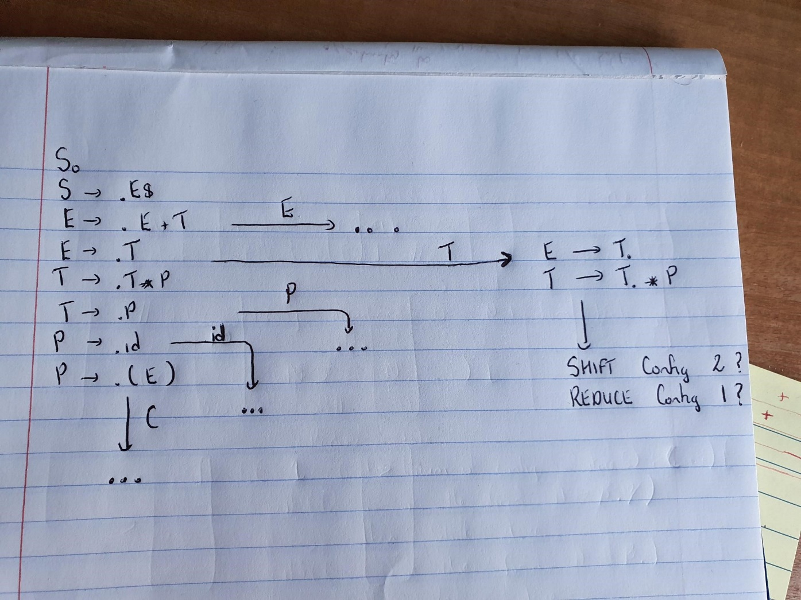
LR(1)
S->E$
E->E+T | T
T->T*P|P
P->id|(E) //id represents 1 terminal to align with the book

Slide 13
LR(1)
E-> T.
T->T.*P
What happens if we get a T transition in state S₀?
  Do we shift or reduce?
  We need extra knowledge, not just past context (on stack) but we also need to know what’s coming next;
  The FSA must contain LA information – what must come next in the language instance, if we choose to reduce;

Slide 14
The Solution: LR(1)
Look ahead 1 token on the input stream;
For each configuration in the state, figure out what token could come after it when it is fully matched (again called the look-ahead component):
If you are in a state where you have a shift-reduce conflict:
  Look at the next input token;
  For the production that you might reduce, see if that token is in its look-ahead set.
  If so, reduce, if not shift.
Notes:
<νυμβερ>

Slide 15
Calculating look-ahead
S->.E$ {lambda }
E->.E+T { }
E->.T { }
T->.T*P { }
T->.P { }
P->.id { }
P->.(E) { }
And specifically state 7 (state 0 under transition T)

Slide 16
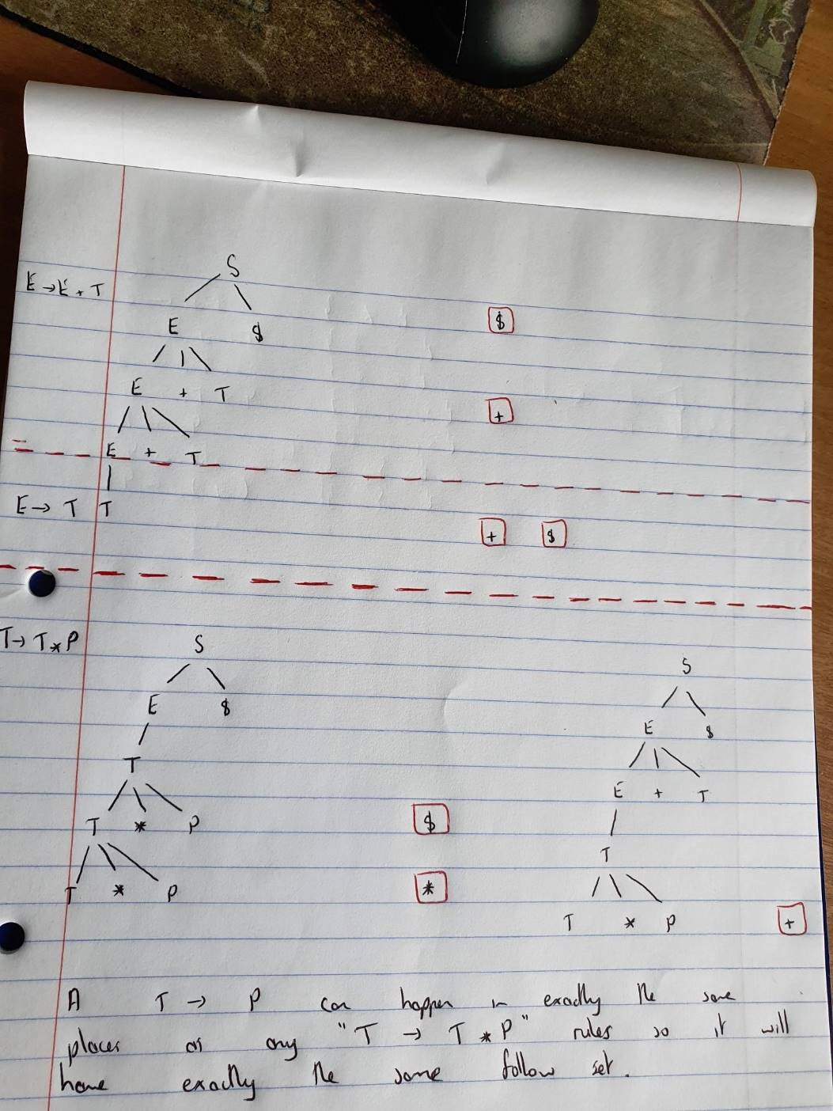

Slide 17
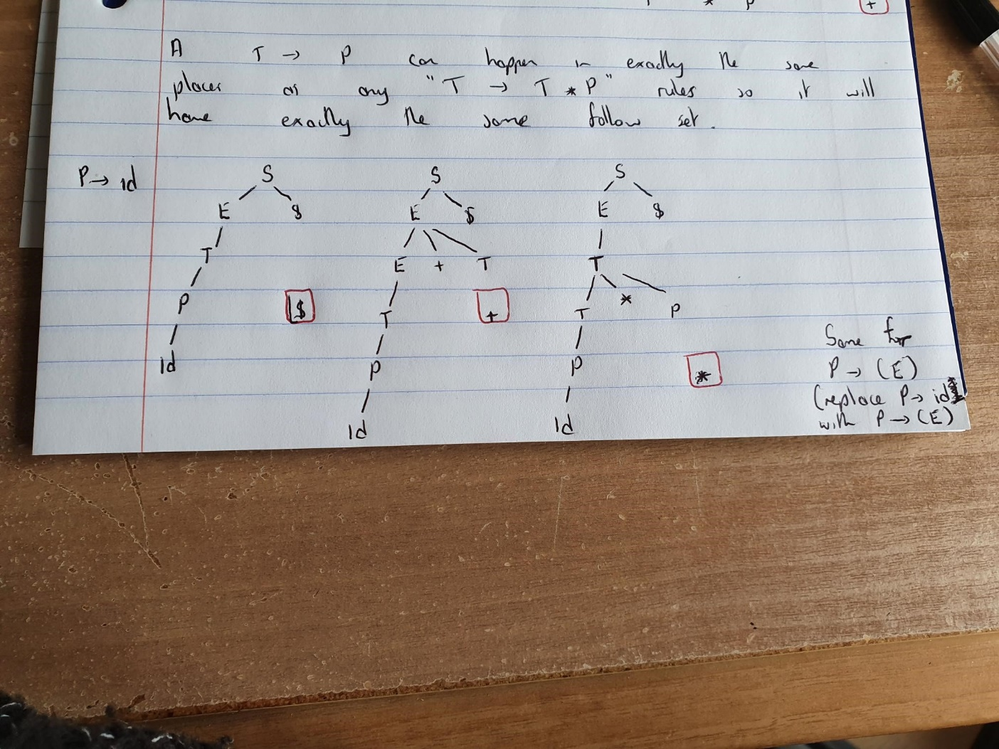
Last 2 Productions

Slide 18
Calculating look-ahead
S->.E$ {lambda }
E->.E+T {$, + }
E->.T {$, + }
T->.T*P {$,*, + }
T->.P {$, *, + }
P->.id {$, +, * }
P->.(E) {$, +, * }
And specifically state 7 (state 0 under transition T)

Slide 19
The solution for our Grammar: State 0 and T transition
State 7:
  E -> T. {$ +}
  T -> T. * P {$ + *}
So if the next thing coming at us in our language instance is $ or + we will reduce T to E
Otherwise we will continue shifting on to an *
Or getting a parsing error…

Slide 20
Another LR(1) Grammar
S -> G r P $
G -> Q
G -> Q a d
Q -> h
P -> g
Create the FSA, goto table, and action table. Show how you would use these tables to parse hadrg$
Notes:
Show we need LR(1) – then get them to do it...
<νυμβερ>

